Slide 1
Module 7b: Java Synchronization
Java Synchronization
Solaris Synchronization
Windows XP Synchronization
Linux Synchronization
Pthreads Synchronization

Slide 2
Java Synchronization
Bounded Buffer solution using synchronized, wait(), notify() statements
Multiple Notifications
Block Synchronization
Java Semaphores
Java Monitors

Slide 3
synchronized Statement
Every object has a lock associated with it
Calling a synchronized method requires “owning” the lock
If a calling thread does not own the lock (another thread already owns it), the calling thread is placed in the wait set for the object’s lock
The lock is released when a thread exits the synchronized method

Slide 4
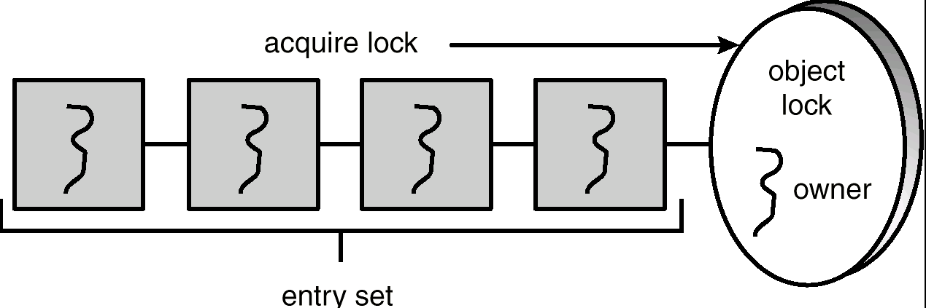
Entry Set

Slide 5
synchronized insert() Method
public synchronized void insert(Object item) {
while (count == BUFFER SIZE)
Thread.yield();
++count;
buffer[in] = item;
in = (in + 1) % BUFFER SIZE;
}

Slide 6
synchronized remove() Method
public synchronized Object remove() {
Object item;
while (count == 0)
Thread.yield();
--count;
item = buffer[out];
out = (out + 1) % BUFFER SIZE;
return item;
}

Slide 7
The wait() Method
When a thread calls wait(), the following occurs:
  the thread releases the object lock
  thread state is set to blocked
  thread is placed in the wait set

Slide 8
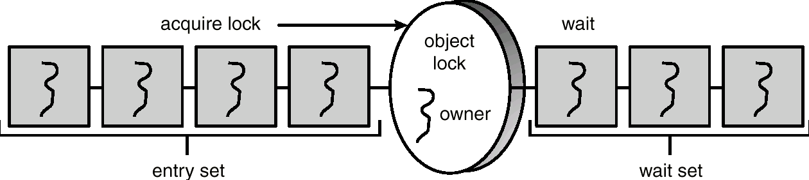
Entry and Wait Sets

Slide 9
The notify() Method
When a thread calls notify(), the following occurs:
  selects an arbitrary thread T from the wait set
  moves T to the entry set
  sets T to Runnable
T can now compete for the object’s lock again

Slide 10
insert() with wait/notify Methods
public synchronized void insert(Object item) {
while (count == BUFFER SIZE) {
try {
wait();
}
catch (InterruptedException e) { }
}
++count;
buffer[in] = item;
in = (in + 1) % BUFFER SIZE;
notify();
}

Slide 11
remove() with wait/notify Methods
public synchronized Object remove() {
Object item;
while (count == 0) {
try {
wait();
}
catch (InterruptedException e) { }
}
--count;
item = buffer[out];
out = (out + 1) % BUFFER SIZE;
notify();
return item;
}

Slide 12
Complete Bounded Buffer using Java Synchronization
public class BoundedBuffer implements Buffer
{
private static final int BUFFER SIZE = 5;
private int count, in, out;
private Object[] buffer;
public BoundedBuffer() { // buffer is initially empty
count = 0;
in = 0;
out = 0;
buffer = new Object[BUFFER SIZE];
}
public synchronized void insert(Object item) { // See previous slides
}
public synchronized Object remove() { // See previous slides
}
}

Slide 13
Multiple Notifications
notify() selects an arbitrary thread from the wait set.
*This may not be the thread that you want to be selected.
Java does not allow you to specify the thread to be selected
notifyAll() removes ALL threads from the wait set and places them in the entry set. This allows the threads to decide among themselves who should proceed next.
notifyAll() is a conservative strategy that works best when multiple threads may be in the wait set

Slide 14
Reader Methods with Java Synchronization
public class Database implements RWLock {
private int readerCount;
private boolean dbWriting;
public Database() {
readerCount = 0;
dbWriting = false;
}
public synchronized void acquireReadLock() { // see next slides
}
public synchronized void releaseReadLock() { // see next slides
}
public synchronized void acquireWriteLock() { // see next slides
}
public synchronized void releaseWriteLock() { // see next slides
}
}

Slide 15
acquireReadLock() Method
public synchronized void acquireReadLock() {
while (dbWriting == true) {
try {
wait();
}
catch(InterruptedException e) { }
}
++readerCount;
}

Slide 16
releaseReadLock() Method
public synchronized void releaseReadLock() {
--readerCount;
// if I am the last reader tell writers
// that the database is no longer being read
if (readerCount == 0)
notify();
}

Slide 17
Writer Methods
public synchronized void acquireWriteLock() {
while (readerCount > 0 || dbWriting == true) {
try {
wait();
}
catch(InterruptedException e) { }
}
// once there are either no readers or writers
// indicate that the database is being written
dbWriting = true;
}
public synchronized void releaseWriteLock() {
dbWriting = false;
notifyAll();
}

Slide 18
Block Synchronization
Scope of lock is time between lock acquire and release
Blocks of code – rather than entire methods – may be declared as synchronized
This yields a lock scope that is typically smaller than a synchronized method

Slide 19
Block Synchronization (cont)
Object mutexLock = new Object();
. . .
public void someMethod() {
nonCriticalSection();
synchronized(mutexLock) {
criticalSection();
}
nonCriticalSection();
}

Slide 20
Java Semaphores
Java does not provide a semaphore, but a basic semaphore can be constructed using Java synchronization mechanism

Slide 21
Semaphore Class
public class Semaphore
{
private int value;
public Semaphore() {
value = 0;
}
public Semaphore(int value) {
this.value = value;
}

Slide 22
Semaphore Class (cont)
public synchronized void acquire() {
while (value == 0)
try {
wait();
} catch (InterruptedException ie) { }
value--;
}
public synchronized void release() {
++value;
notify();
}
}

Slide 23
Syncronization Examples
Solaris
Windows XP
Linux
Pthreads

Slide 24
Solaris Synchronization
Implements a variety of locks to support multitasking, multithreading (including real-time threads), and multiprocessing
Uses adaptive mutexes for efficiency when protecting data from short code segments
Uses condition variables and readers-writers locks when longer sections of code need access to data
Uses turnstiles to order the list of threads waiting to acquire either an adaptive mutex or reader-writer lock

Slide 25
Windows XP Synchronization
Uses interrupt masks to protect access to global resources on uniprocessor systems
Uses spinlocks on multiprocessor systems
Also provides dispatcher objects which may act as either mutexes and semaphores
Dispatcher objects may also provide events
  An event acts much like a condition variable

Slide 26
Linux Synchronization
Linux:
  disables interrupts to implement short critical sections
Linux provides:
  semaphores
  spin locks

Slide 27
Pthreads Synchronization
Pthreads API is OS-independent
It provides:
  mutex locks
  condition variables
Non-portable extensions include:
  read-write locks
  spin locks

